Slide 1
Rockbuster Stealth LLC Movie Rental Analysis
Luca Verderio
June 2022

Slide 2
Agenda / Topics
Objectives and Tools
Business Questions
Analysis
Key Findings/Results
Recommendations

Slide 3
Objectives and Tools
Glean insights to support Rockbuster Stealth LLC with the launch of an online video rental service
Provide Rockbuster Stealth LLC with data-driven answers to business questions in order to develop a new business strategy
The following tools have been used:
PostgreSQL: relational database management system (RDBMS)
Tableau: data visualization software
Excel: data analysis and data visualization software

Slide 4
Business Questions
Which movies contributed the most/least to revenue gain?
What was the average rental duration for all videos?
Which countries are Rockbuster customers based in?
Where are customers with a high lifetime value based?
Do sales figures vary between geographic regions?

Slide 5
Revenue: Best and Worst Movies
The movie with the highest revenue is “Telegraph Voyage”, totalling $215.75
The movie with the lowest revenue is “Texas Watch”, totalling $5.94

Slide 6
Revenue: Rating and Category
The rating with the highest revenue is “PG-13”, totalling $13,855.56
The category with the highest revenue is “Sports”, totalling $4,892.19

Slide 7
Descriptive Statistics
 | Minimum | Maximum | Average
Rental duration [days] | 3 | 7 | 4.99
Rental rate [$] | 0.99 | 4.99 | 2.98
Length [minutes] | 46 | 185 | 115.27
Replacement cost [$] | 9.99 | 29.99 | 19.98
 | Mode
Rating | PG-13
The average rental duration is 4.99 days, with a minimum of 3 and a maximum of 7 days
The rating that appears the most in the data set is PG-13

Slide 8
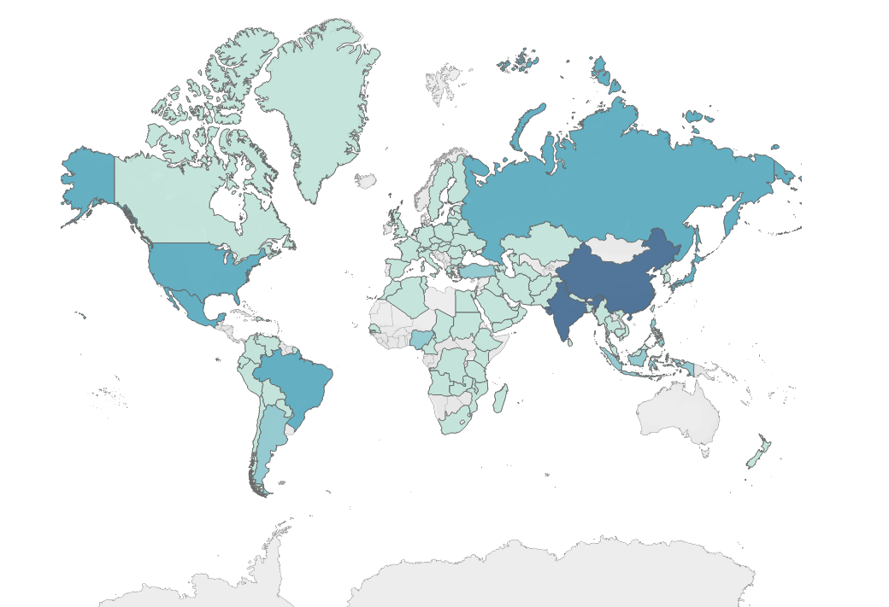
Spatial Analysis: Customers Count by Country
Legend: number of customers
Tableau: link
1
60

Slide 9
Lifetime Value: Top 10 Customers
Top 10 customers worldwide by number of transactions and total expense over 150$
Country | Customer ID | Name | Last name | Total spent [$] | No. of transactions
Reunion | 148 | Eleanor | Hunt | 211.55 | 45
United States | 526 | Karl | Seal | 208.58 | 42
Belarus | 144 | Clara | Shaw | 189.6 | 40
Brazil | 178 | Marion | Snyder | 194.61 | 39
Philippines | 236 | Marcia | Dean | 166.61 | 39
Netherlands | 137 | Rhonda | Kennedy | 191.62 | 38
Canada | 410 | Curtis | Irby | 167.62 | 38
Iran | 459 | Tommy | Collazo | 183.63 | 37
Spain | 469 | Wesley | Bull | 158.65 | 35
Philippines | 373 | Louis | Leone | 156.66 | 34
Customers with the highest lifetime value: top 10 customers in terms of number of transactions and total expense over 150$

Slide 10
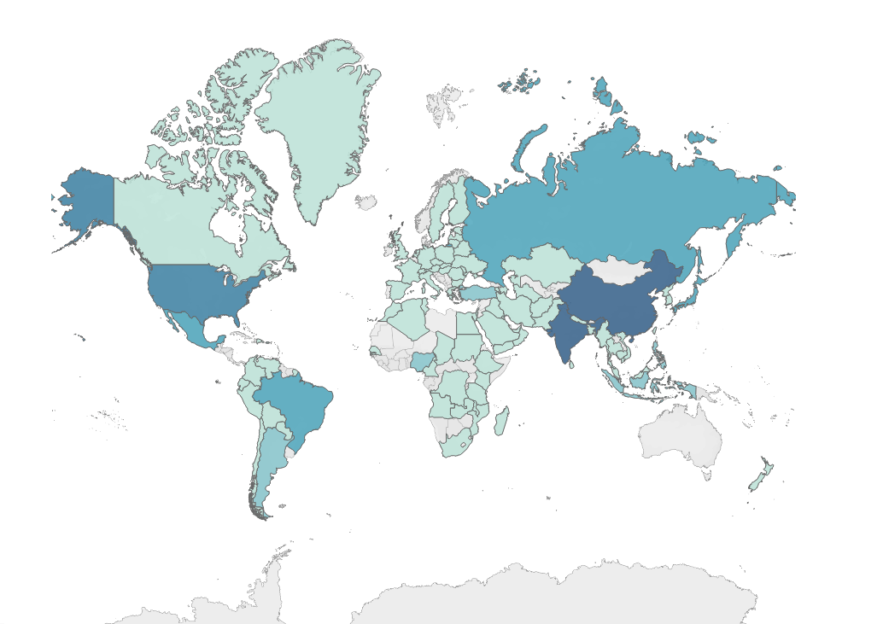
Geographic Regions: Revenue by Country
Legend: revenue [$]
Tableau: link
48
6,035

Slide 11
Geographic Regions: Revenue by Rating
The rating with the largest revenue among the top 10 countries (in terms of total revenue) is PG-13

Slide 12
Geographic Regions: Revenue by Category
The category with the largest revenue among the top 10 countries (in terms of total revenue) changes from country to country

Slide 13
Key Findings/Results
Which movies contributed the most/least to revenue gain?
The movie that contributed the most is "Telegraph Voyage" ($215.75)
The movie that contributed the least is "Texas Watch" ($5.94)
The rating that contributed the most is “PG-13” ($13,855.56)
The rating that contributed the least is “G”, ($10,511.88)
The category that contributed the most is “Sports” ($4,892.19)
The category that contributed the least is “Thriller” ($47.89)
What was the average rental duration for all videos?
The average rental duration is 4.99 days, with a minimum of 3 and a maximum of 7 days

Slide 14
Key Findings/Results
Which countries are Rockbuster customers based in?
The top 10 countries by number of customers are: India, China, United States, Japan, Mexico, Brazil, Russian Federation, Philippines, Turkey, Indonesia
Where are customers with a high lifetime value based?
The top 10 customers worldwide, by number of transactions and total expense over 150$, are based in: Reunion (ID 148), United States (ID 526), Belarus (ID 144), Brazil (ID 178), Philippines (ID 236), Netherlands (ID 137), Canada (ID 410), Iran (ID 459), Spain (ID 469), Philippines (ID 373)

Slide 15
Key Findings/Results
Do sales figures vary between geographic regions?
The top 10 countries by total revenue are: India, China, United States, Japan, Mexico, Brazil, Russian Federation, Philippines, Turkey, Indonesia
The top 10 countries by total revenue are also the top 10 countries by number of customers
The rating that contributed the most to the revenue in each of the top 10 countries (in terms of total revenue) is “PG-13”
The category that contributed the most to the revenue changes from country to country

Slide 16
Recommendations
The online rental service should initially focus on the biggest contributors to revenue
Consider the preferred movie rating and category in each country to better target the interest of its population
The online rental service should initially be deployed in countries with the largest numbers of customers (and largest total revenue)
Gather as much information as possible regarding the service
Collect feedbacks from the customers

Slide 17
Recommendations
Deals could be offered to customers with a high lifetime value that are based in countries where the online rental service will be deployed
For example, the first movie rented through the online service could be free
Rewards could be offered to customers with a high lifetime value that are based in countries where the online rental service will not be initially available, to maintain their loyalty

Slide 18
Questions?
Thank you

